Slide 1

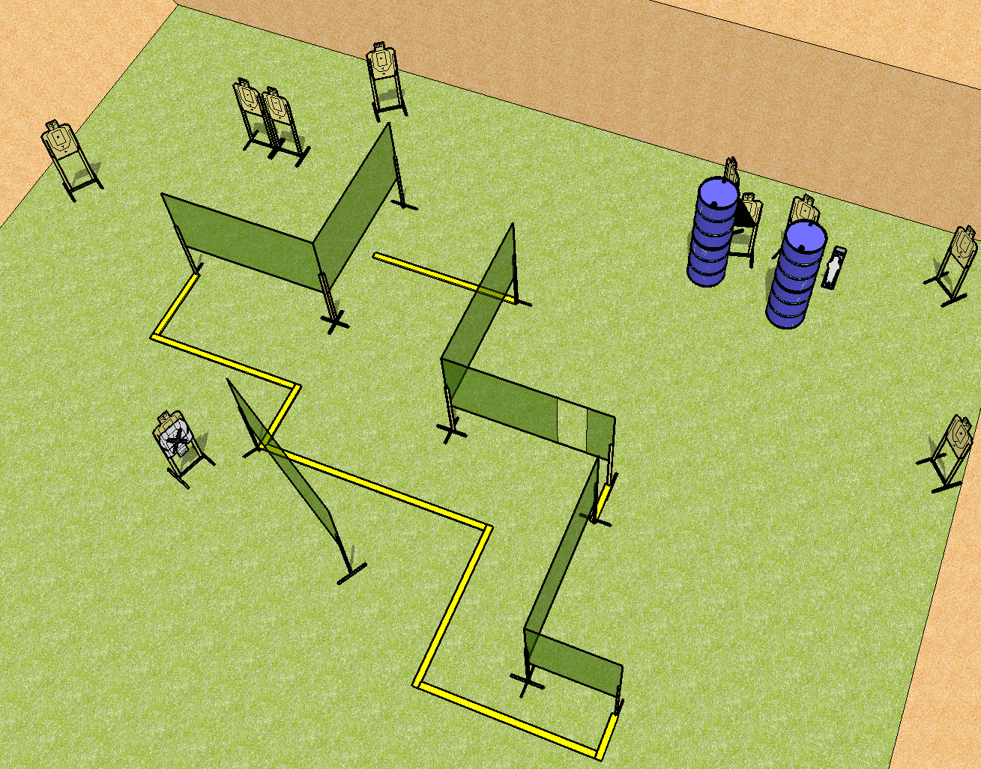
 | Dothan Practical Shooters – USPSA Match Stairway to Nowhere Course Designer : Drew Coleman Bay: B3
Round Count 21 rounds 10 USPSA 1 mini popper
Equipment List 11 wall feet 1 right diag 10 targets (9 + 1NS)

Slide 2
Stairway to Nowhere
Written Stage Briefing
Scoring: Comstock Rounds: 21
Targets: 10 USPSA, 1 steel
Handgun start position: inside the shooting area, wrists below belt. Handgun is loaded and holstered.
PCC start position: inside the shooting area, stock on belt. Loaded carbine is held with both hands, safety on.
Stage Procedure: on the audible start signal engage targets as they become available from within the shooting area.

